Slide 1

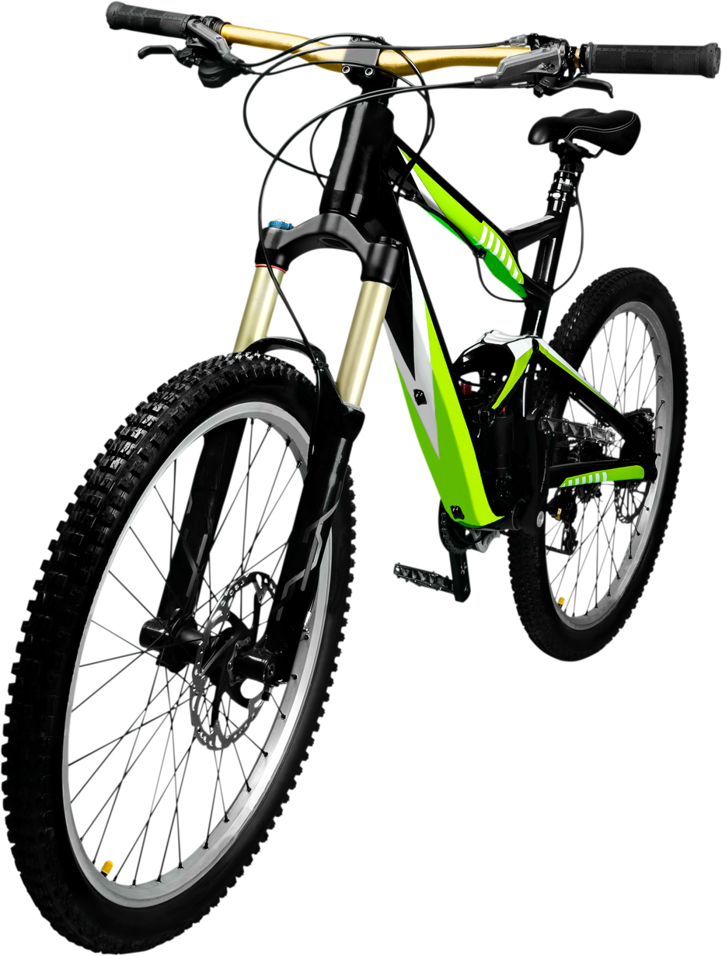
CYCLISTIC
BIKE-SHARE
Presented by Priscilla Aihoon

Slide 2
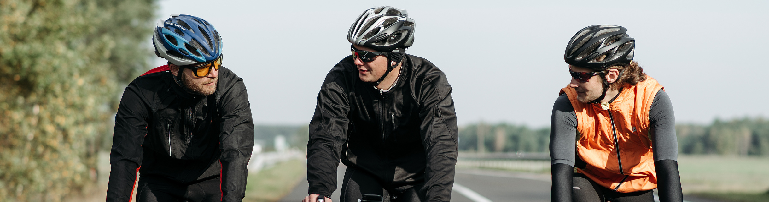
Grow annual memberships by understanding differences in usage between casual riders and members.
Use insights to drive a targeted marketing strategy
BUSINESS
OBJECTIVE

Slide 3
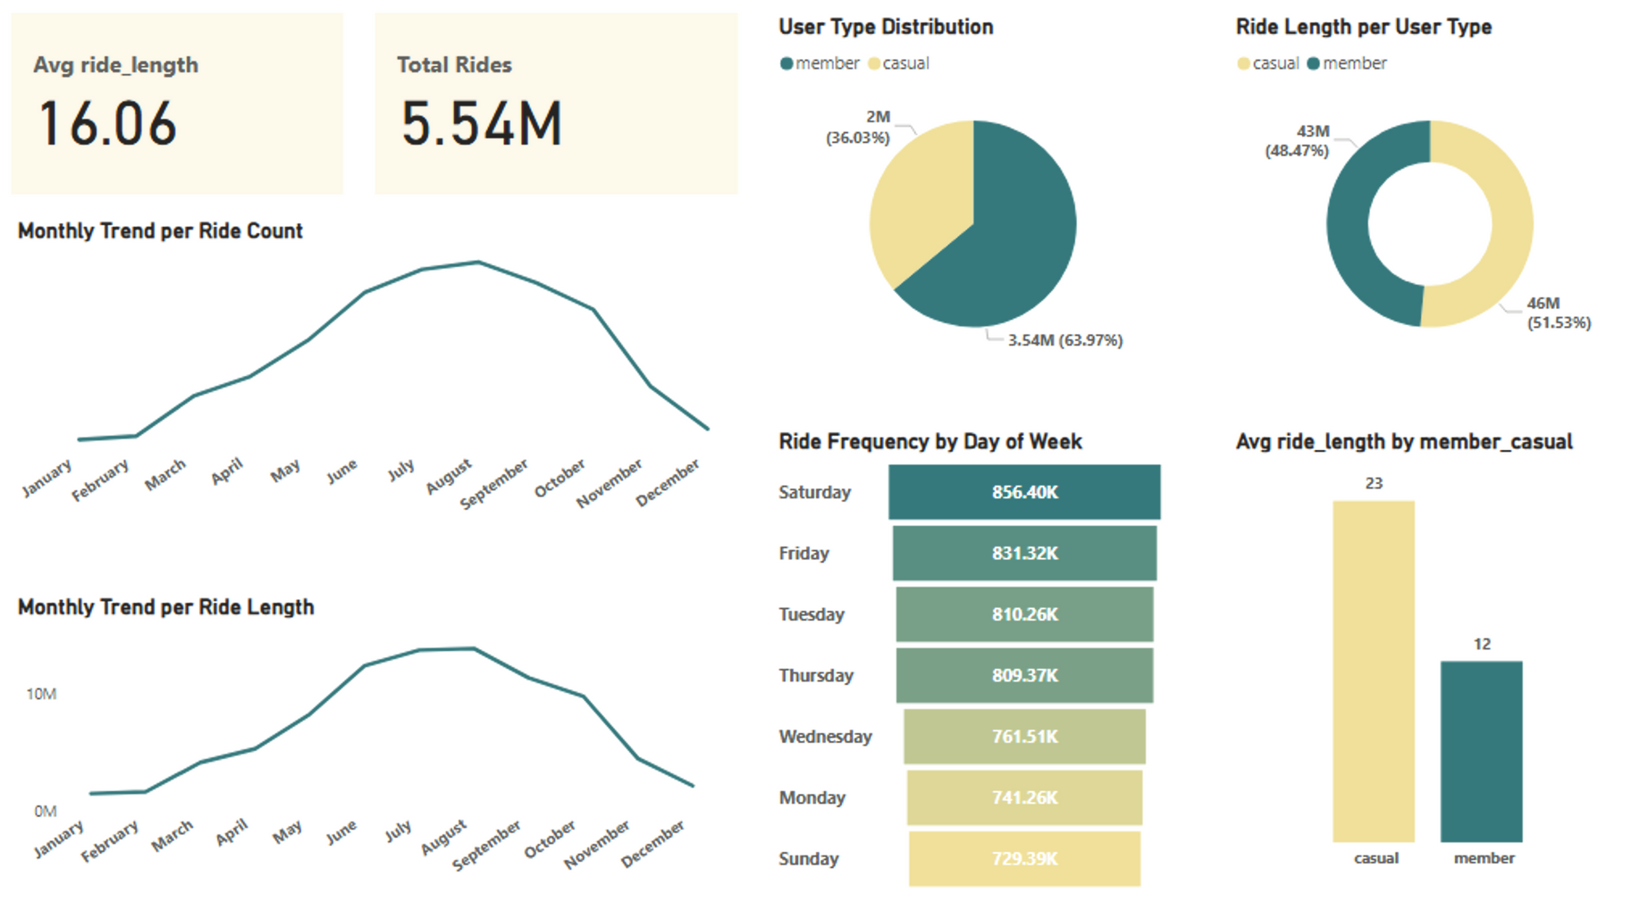
EXECUTIVE SUMMARY

Slide 4
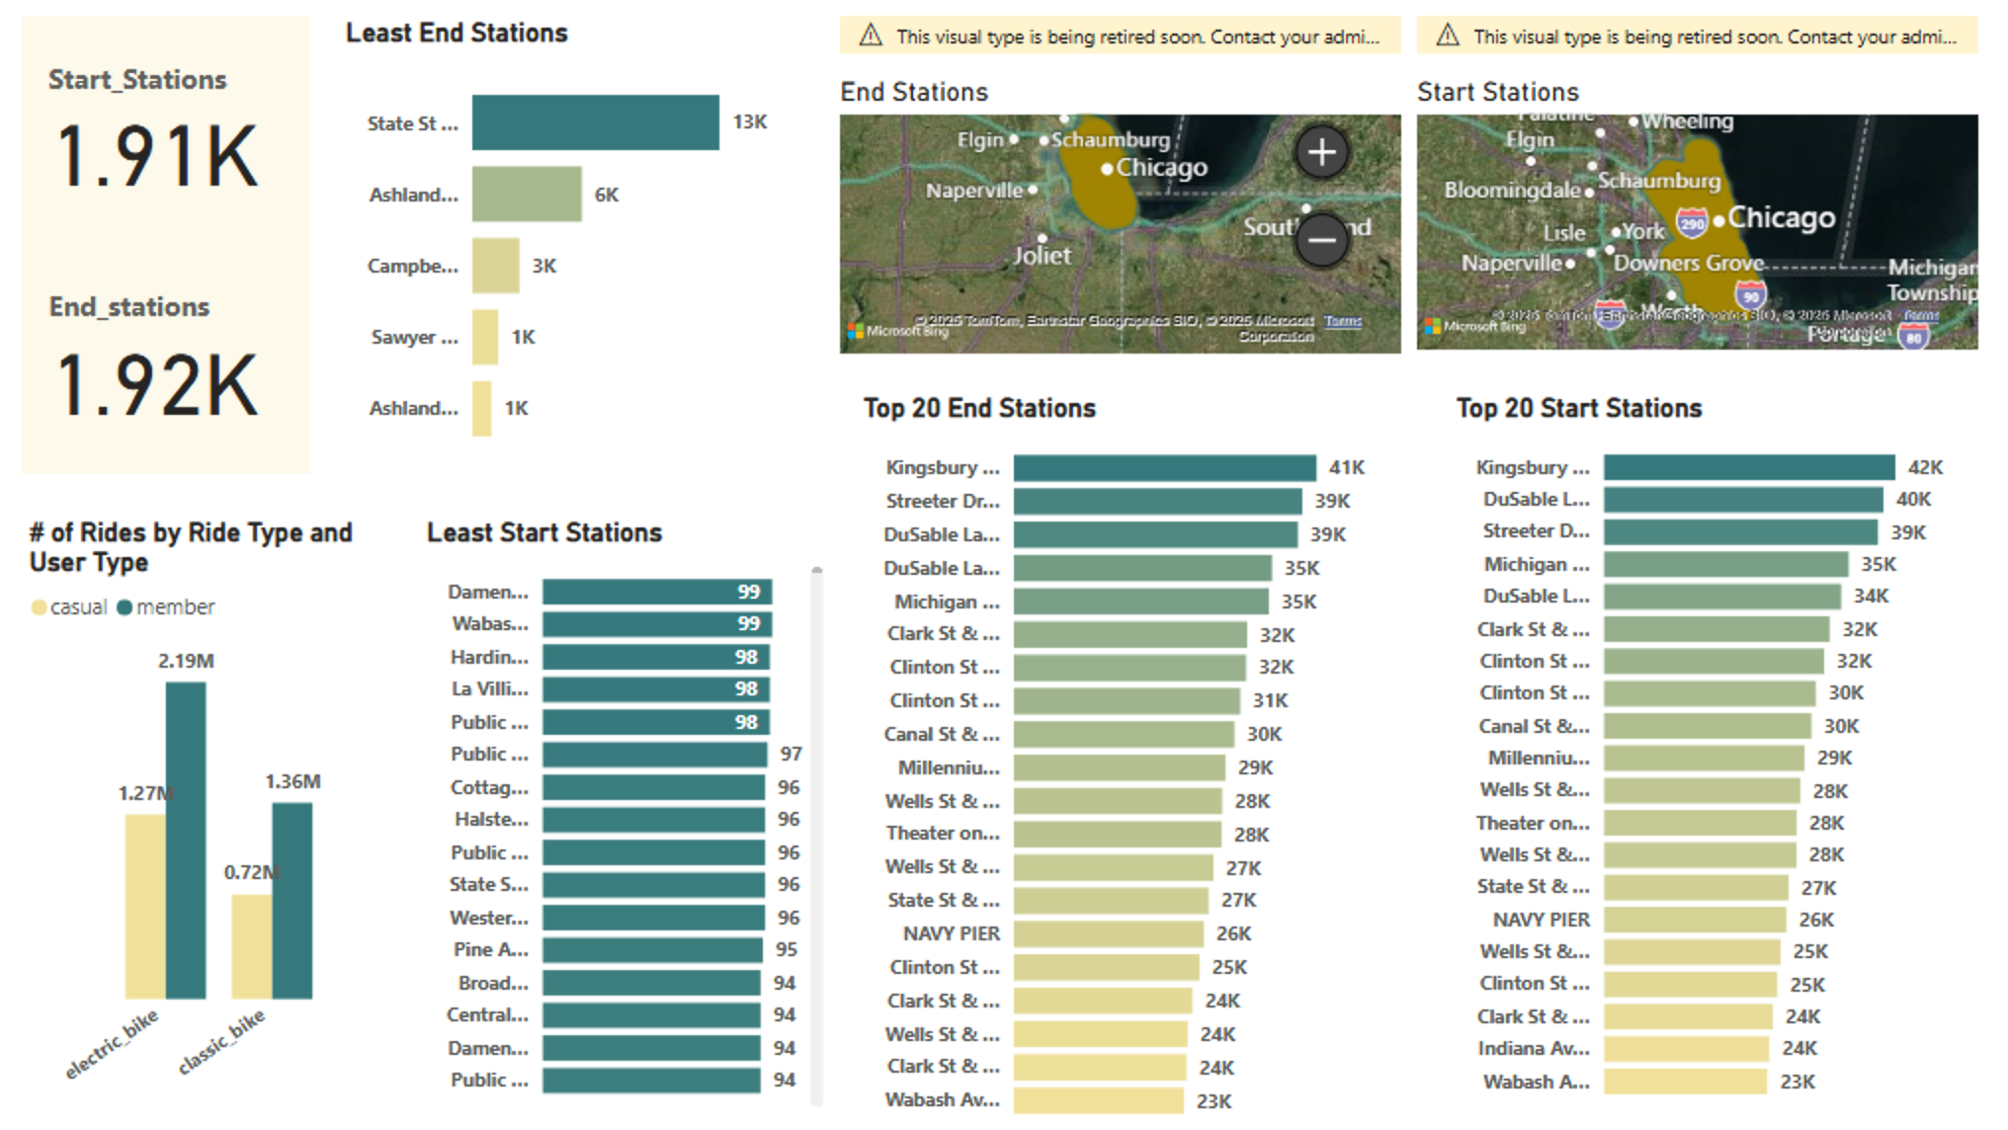
OPERATIONAL
METRICS
There are more end stations than starts stations
E-bike and classic bike usage metrics reveal different rider preferences
Most of the Public Stops are the least frequently used

Slide 5
GEOGRAPHIC
METRICS
The most popular start and end stations are clustered in key Chicago neighborhoods.
More rides originate and end at high-traffic stations like Kingsbury and Streeter Drives

Slide 6
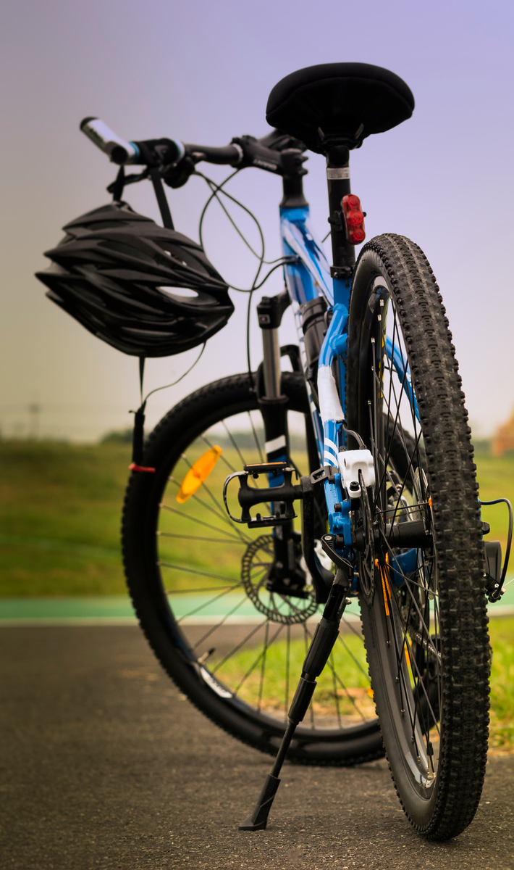

KEY
INSIGHTS
64% of rides by annual members; 36% by casual riders
Members take shorter, more frequent rides during weekdays (commute behavior)
Casual riders take longer rides, favor weekends (leisure behavior)
Peak bike usage on Saturdays and in summer months (seasonality)
Most rides start/end at popular downtown and commuter stations
Clear opportunity to convert casual riders using targeted promotions

Slide 7

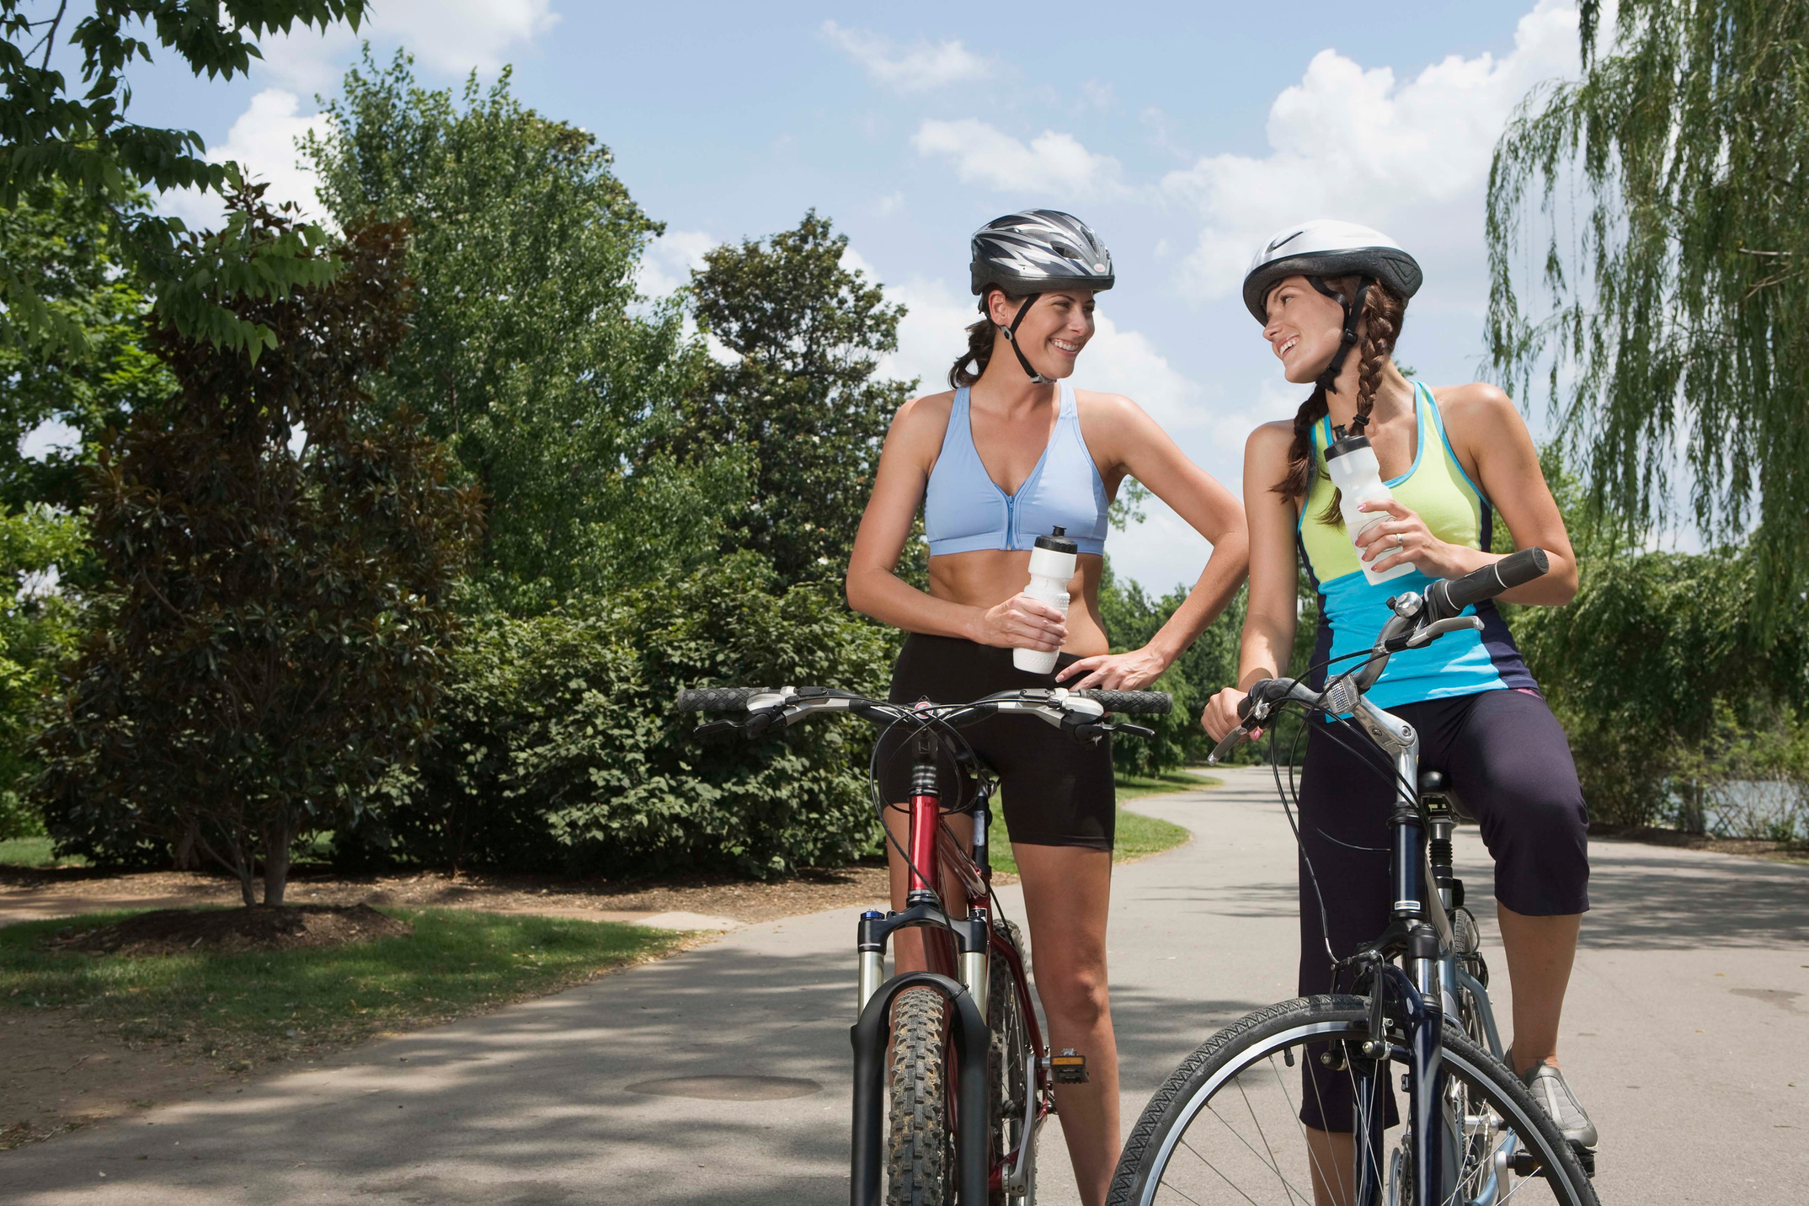

RECOMMEN
DATIONS
Launch targeted summer and weekend marketing campaigns focused on casual riders
Offer incentives and bundled discounts to encourage casual riders to become members
Enhance member benefits such as exclusive access and priority bike availability
Optimize station inventory based on usage peaks to improve availability and satisfaction
Use data-driven insights to tailor promotions around ride patterns and popular stations

Slide 8
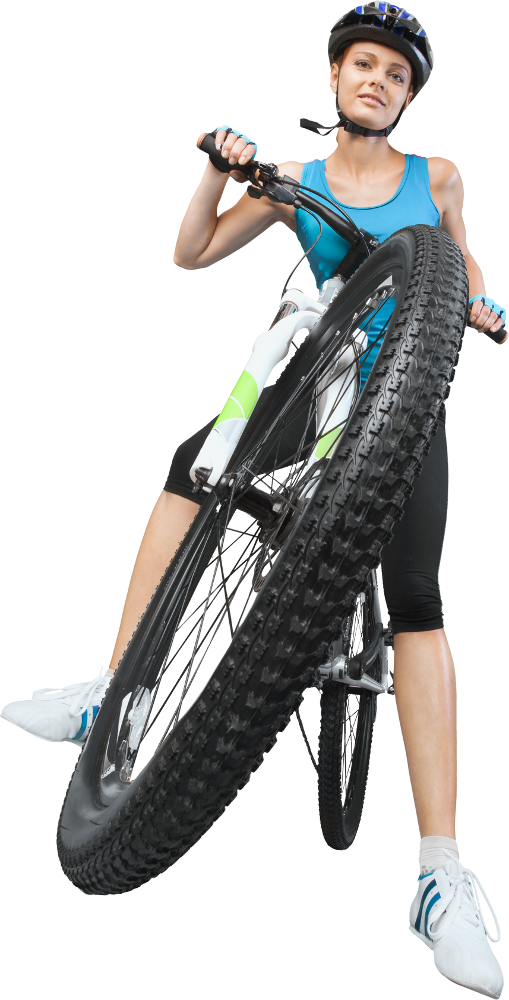
THANK YOU
QUESTIONS?

